Slide 1


Turn your co-workers into your
best ambassadors!
Referrals
Internal mobility
Employer brand

Slide 2

3 critical levers for your hiring process
37%
The referral program
of recruited candidates are already known by at least one person in the company
Make sourcing easier thanks to your co-workers!
43%
Hire high quality profiles thanks to referrals.
of people hired via referral stay over 3 years
(vs. 14% of those hired through job boards)
Sources : Apec 2018 edition and Bill Boorman « The Social Referral ».

Slide 3

3 critical levers for your hiring process
5%
Internal mobility
Internal mobility represented less than 5% of all hires in 2018
A source of talents rarely tapped into…
60%
… even if co-workers are demanding it!
of co-workers would opt to move within their companies if possible
Sources : HAYS 2019

Slide 4
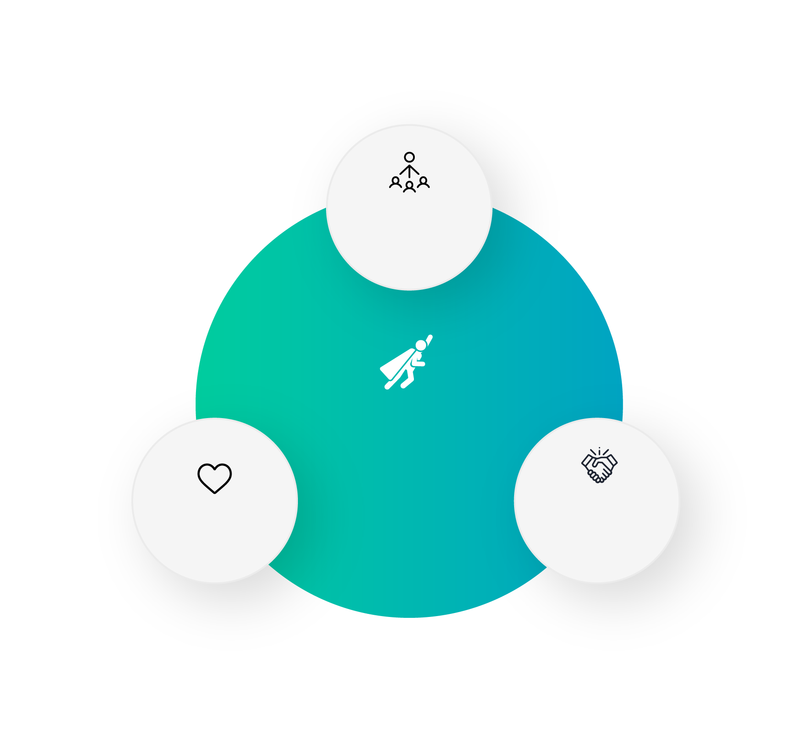

3 critical levers for your hiring process
An ambassadors system
Sourcing
made easier
thanks to co-workers referrals
By placing your co-workers at the heart of your HR strategy, you will make them your ambassadors and kick-off a virtuous circle.
The co-workers at the
heart of your strategy
Did you know?
When hearing about a company, the opinion from an employee is taken 3 times more seriously than the opinion from the CEO!
Outreach
Retention
of your employer
brand
of talent thanks to
Internal mobility
Source : Edelman Trust Barometer.

Slide 5


Why equip yourself with a digital tool?
The artisanal method has its limits!

Slide 6
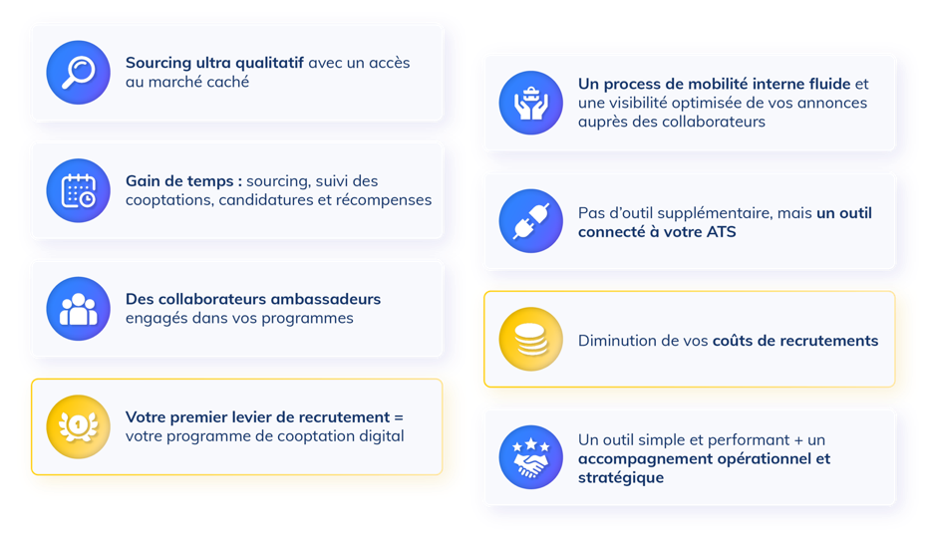
Keycoopt System
Benefits of the solution
High quality sourcing with access to the hidden market
A smooth internal mobility process and optimized visibility of your jobs opportunities among co-workers
Time saving: sourcing, follow-up of referral, applications and rewards
No additional tool, but a tool connected to your ATS
Co-workers ambassadors engaged in your programs
Reduction of your recruitment cost
Your first hiring lever =
Your digital referral program
A simple and efficient tool + operational and strategic support

Slide 7

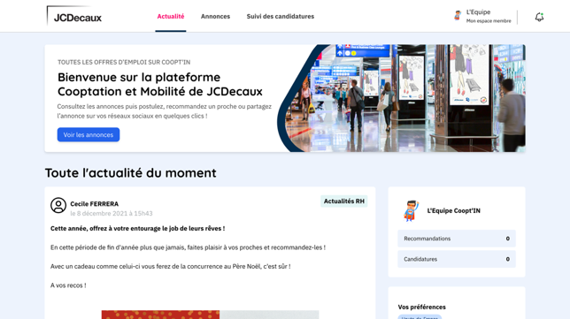
Recruiting solution by referral and internal mobility
1
SaaS and white label solution
2
A multilingual platform to bring all your co-workers on board with a single tool
3
A continuous support with a dedicated Customer Satisfaction Manager
4
An expertise in recruitment and especially in referral and internal mobility programs since 2012

Slide 8

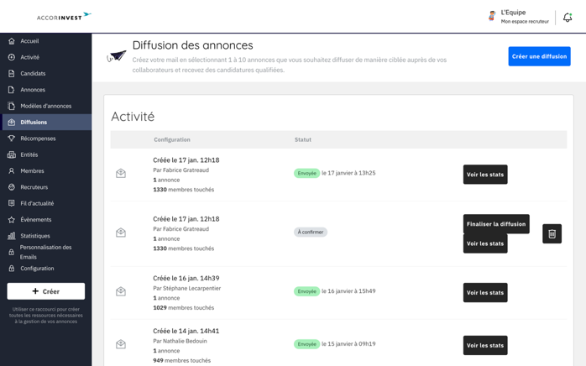
Key functionalities
An automated and targeted broadcast
100% of the jobs advertisements are sent to the right co-workers thanks to a matching algorithm
Automated steps to save more time
Notes:
Rogner la fin de la vidéo

Slide 9
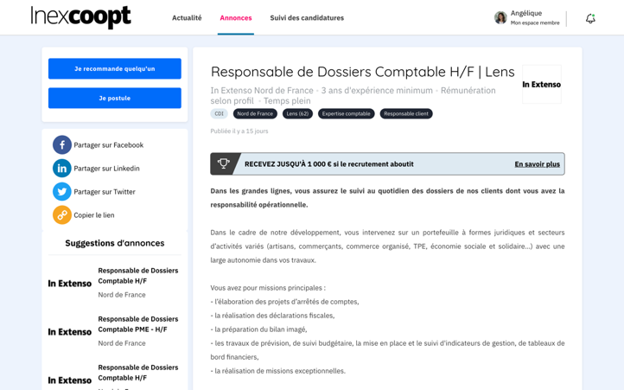
Main features
A sourcing made easier thanks to your staff
When looking at a job description, several choices can be made:
Refer
Someone from your network
Apply for the job
To move up in the company
Share
The job opportunity on social medias

Slide 10
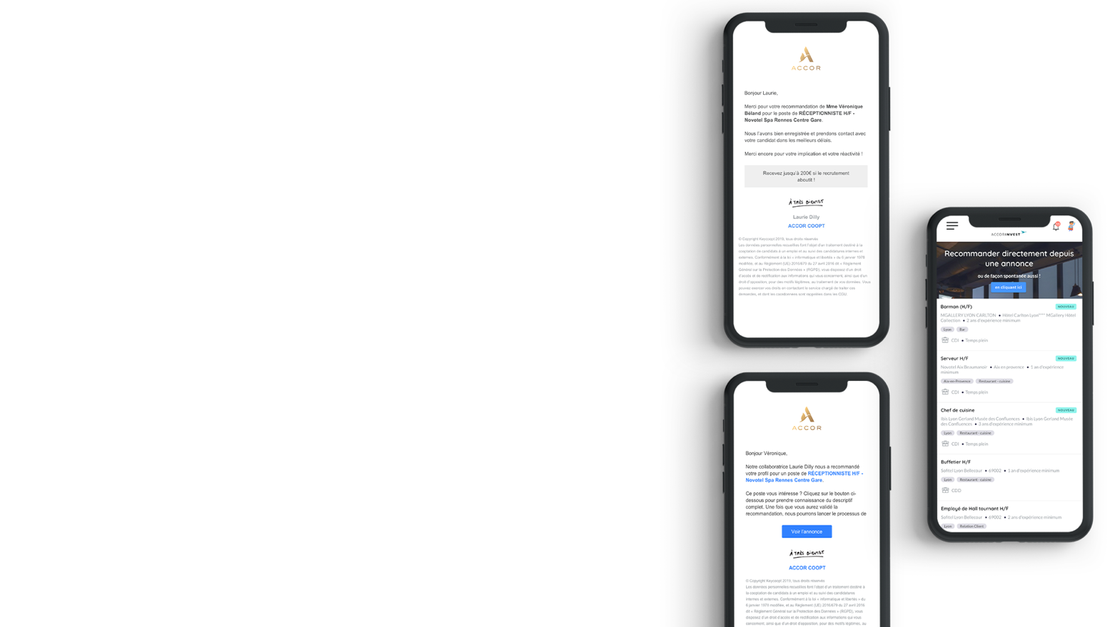
Main features
A unique co-worker and candidate experience
Send a powerful and very positive trusted message that relies on full transparency
Candidates and co-workers are aware of each step of the recruiting process thanks to an automated email workflow.

Slide 11
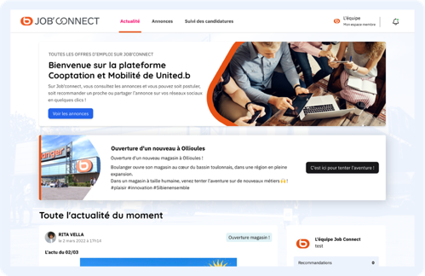
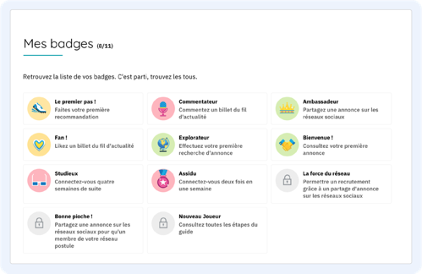
Key functionalities
Communicating in your style and managing your community
Your employer brand is front and center from the login page
Several community management and gamification tools (Newsfeed, Badges, Reward Levels...)

Slide 12
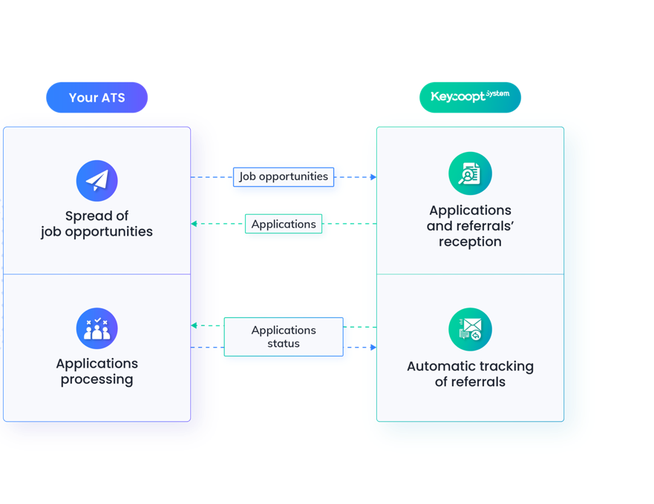



Keycoopt System
connects to your ATS
As a recruter, the management of your job opportunities and applications can be done directly from your ATS
…

Slide 13


Much more than a tool, a service dedicated to our customers

Slide 14




Support
A project manager dedicated to the success of your strategy
Before the launch
1
Advices for the implementation of your referral/internal mobility program |Customization of your platform | Training to the tool | Test phase | Project coordination | Help for your launching communication | Integration to your ATS
During the launch
2
Onboarding of the members | Advices and presence for the launching event | Quality and Technical control | 1st assesment
Our Customer Satisfaction Managers
Keycoopt System
After the launch
3
Sharing of best practices | Consulting in community animation |
Follow-up of KPIs and referrals | Users Klub | Continuous training of teams | Regular review
Notes:
Texte non travaillé

Slide 15


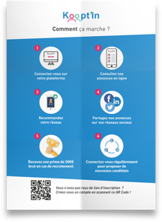
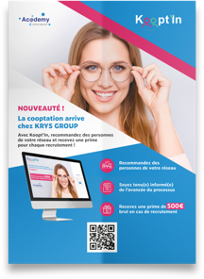
Support
A marketing team you can rely on to help you build your communication plan
Notes:
Ajouter des exemples visuels de ce qu’on fait (mockups)

Slide 16

Our aim
Your co-workers
Supporting you throughout the development of your sourcing ecosystem
Your best candidates
Your interns
Involve all the players in your ecosystem
Make them the 1st lever of your development
Your suppliers
Your former co-workers /Alumni

Slide 17

A proven solution,
a unique ROI!

Slide 18
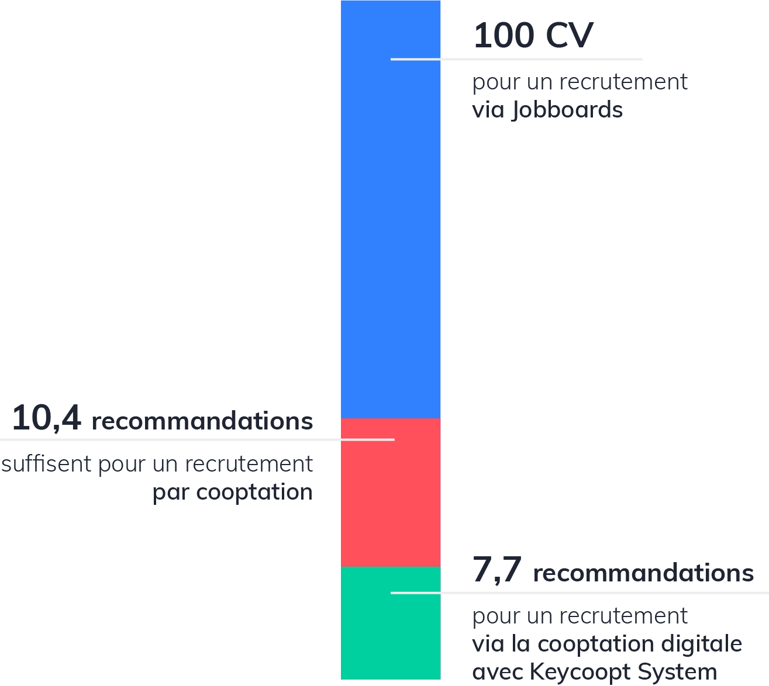
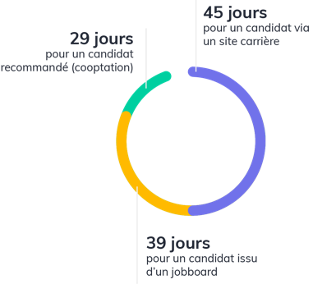
2 key indicators
A solution with a unique ROI!
Applicants/hires ratio
Average lengh of hiring process
100 CVs
45 days
For a recruitment through Jobboards
29 days
For an applicant from a career site
For a referred applicant
10,4 referrals
Are enough for a hire through traditional referral programs
7,7 referrals
39 days
For an applicant from a jobboard
For a hire through Keycoopt System’s digital referral platform
… and let’s not forget that the hiring cost is 2 to 3 times lower!
Source : Bill Boorman « The Social Referral »
Notes:
Juste pour exemple : en attente de stats

Slide 19
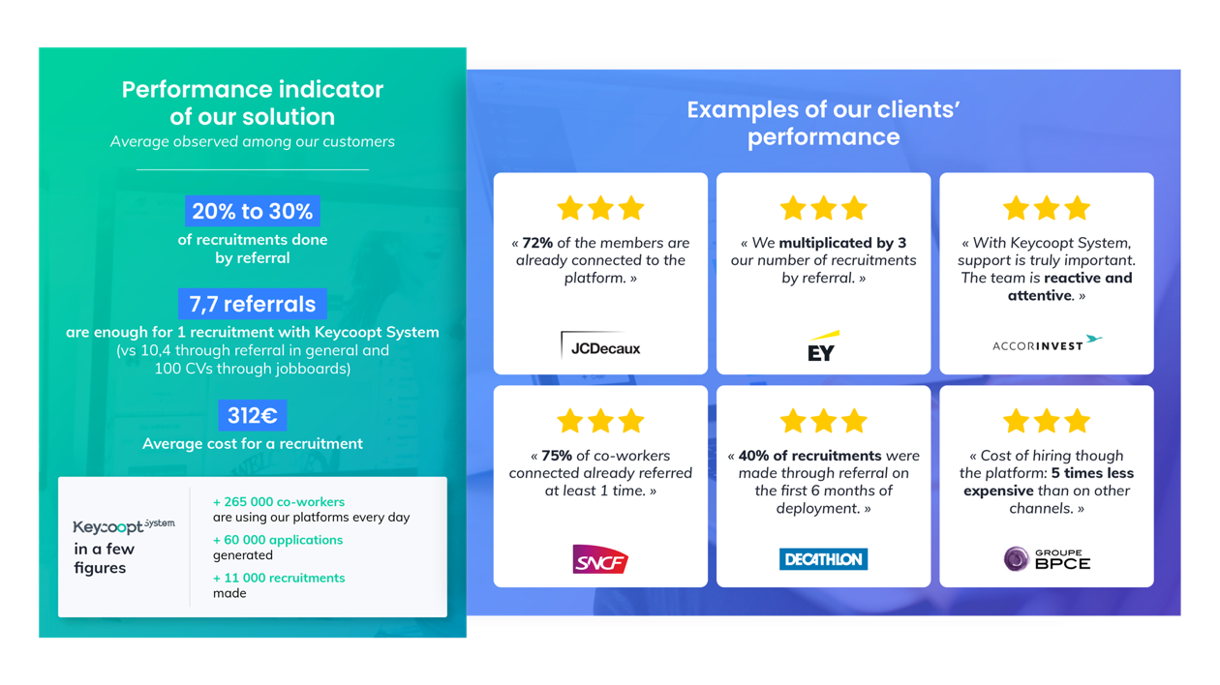
20 à 30%
Notes:
Juste pour exemple : en attente de stats

Slide 20

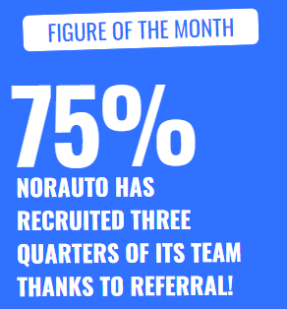

Business Case
Norauto
« When you compare it to traditional referral as we used to experience it, it’s almost 3 times more referrals! »
Stéphane Wilmotte - HRD France – Norauto
Already practising referral but in a « home-made » way, the Norauto company had 3 challenges:
1
Diversify its recruitment sources (1000 recruitments / year) and facilitate the act of referral
2
Animate the co-workers aroundthe referral program
3 years after it’s been online
3
Improve tranparency regarding internal job openings (400 centers) and make co-workers actors of their mobility!
6803 members
Converstion rate of one referral
Recruitment cost by referral
758 referrals
271 applications
Less than
400€
46%
402 recruitments and/or internal mobility
Notes:
A compléter

Slide 21
Why choose
Keycoopt System ?

Slide 22
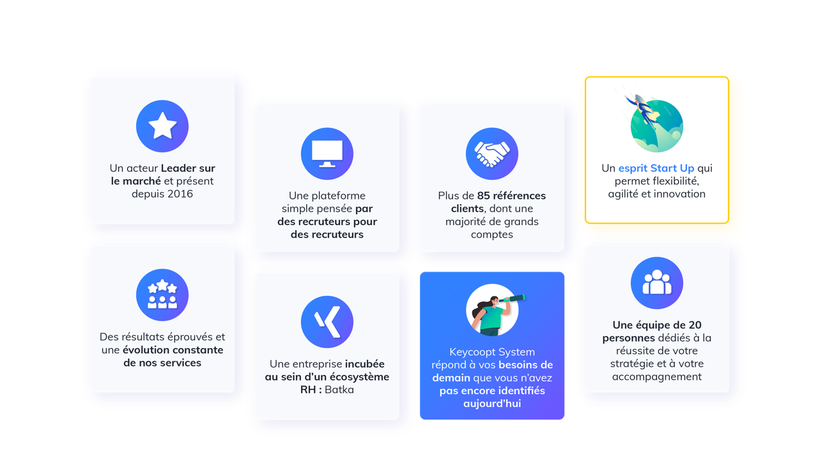
Our strenghts
A market Leader and present since 2016
A start-up spirit that allows flexibility, agility and innovation
An easy platform designed by recruiters for recruiters
More than 85 clients references, including a majority of major accounts
A team of 20 people dedicated to the success of your strategy and to your support
Proven results and constant evolution of our services
Keycoopt System answers your needs of tomorrow that you have not yet identified today
An incubated company within an HR ecosystem: Batka
Notes:
Juste pour exemple : en attente de stats

Slide 23
We continue to move forward…
The next steps

Slide 24
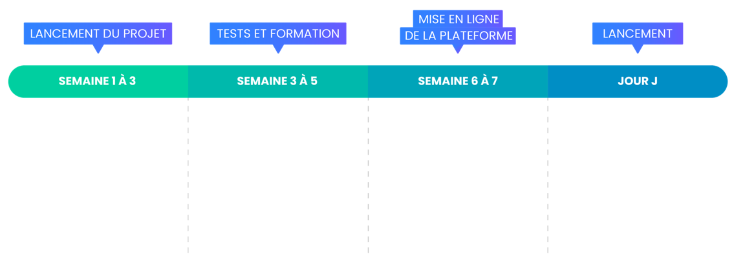
The big steps of the project
PUTTING THE PLATFORM ONLINE
PROJECT LAUNCHING
TESTS AND TRAINING
LAUNCHING
WEEK 1 TO 3
WEEK 3 TO 5
WEEK 6 TO 7
D-DAY
Kick Off meeting
Configuration and customization of the plateform (name, color, logo, visuals, segments…)
Definition of your referral and/or mobility program (rules, terms and conditions, rewards…)
Implementation of the test platform
Test & Learn (and adjustment if needed)
Start of the training of administrators and recruiters
Preparation of communication plan
Putting the platform online
Import of the members
Last tests
Communication and teasing with co-workers
Continuation of the trainings
Beginning of the communication actions
Onboarding of members
Quality and technical control
Notes:
Juste pour exemple : en attente de stats

Slide 25
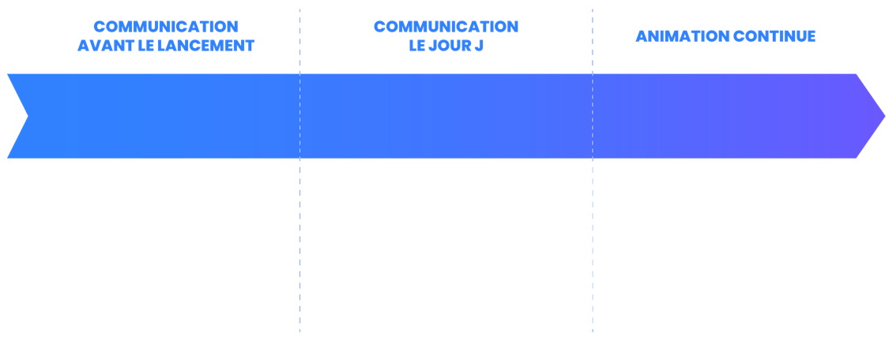


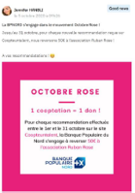
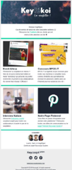

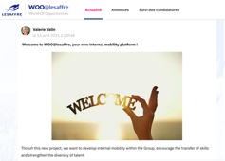
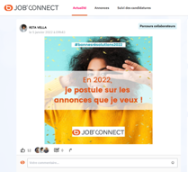
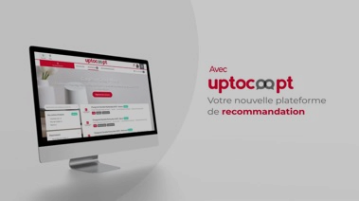

Communication and animation,
The key to success!
COMMUNICATION BEFORE LAUNCHING
COMMUNICATION
ON D-DAY
ANIMATION CONTINUES
Teasing | Display | Prensation video | Member’s guide| Launch pack
Welcome email | Launch event | News feed communication
Automatic animation emails | Users Klub | Animation guide and monthly operations | Video interview
Notes:
Juste pour exemple : en attente de stats

Slide 26





























They trust us

Slide 27

www.keycooptsystem.com
Notes:
Slide à travailler

